Slide 1
UMET9U-30-1- Professional Skills for Banking and Finance Lecture 20
Presented by
Reinhold Heinlein
March 2026

Slide 2
Lecture content
Hypothesis testing

Slide 3
Hypothesis testing
In the previous lecture, we showed how a sample can be used to develop point and interval estimates of population parameters.
In a statistical test, we are making a tentative assumption about a population parameter.
Depending on findings of the sample we either reject or not reject the assumption.

Slide 4
The 5 steps in hypothesis testing
Write down what you are testing: Null and alternative hypothesis.
Compute a test statistic from the sample data.
Look up a critical value in a statistical table.
Decision: Reject or not reject the null.
Conclusion: What can be learned from the test.

Slide 5
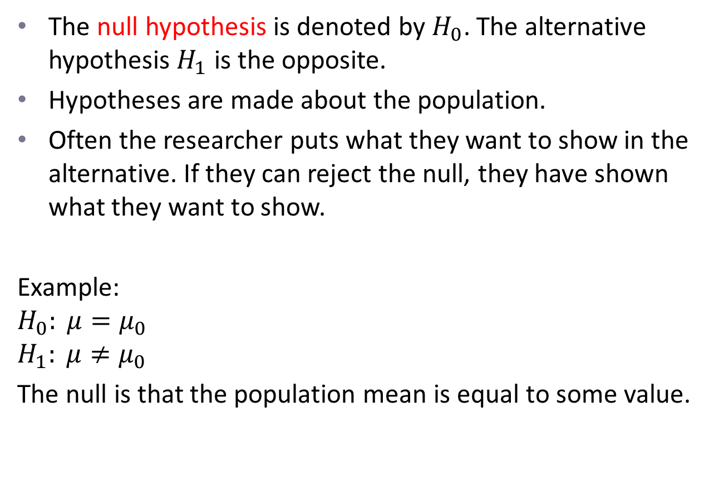
Step 1: Formulate null and alternative hypothesis
The null hypothesis is denoted by $H_{0}$. The alternative hypothesis $H_{1}$ is the opposite.
Hypotheses are made about the population.
Often the researcher puts what they want to show in the alternative. If they can reject the null, they have shown what they want to show.
Example:
$$H_{0}: μ=μ_{0}$$
$$H_{1}: μ≠μ_{0}$$
The null is that the population mean is equal to some value.

Slide 6
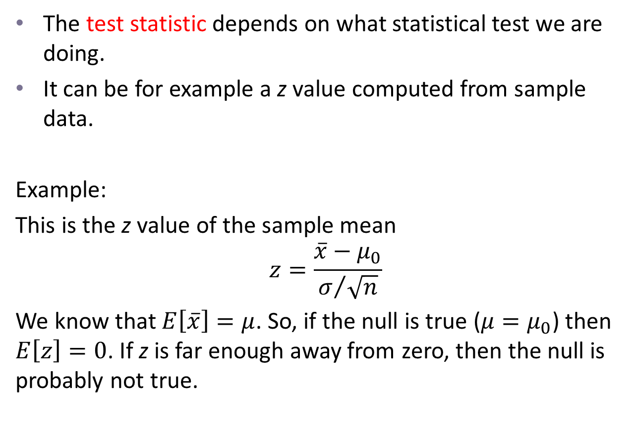
Step 2: Compute a test statistic from the sample data
The test statistic depends on what statistical test we are doing.
It can be for example a z value computed from sample data.
Example:
This is the z value of the sample mean
$$z=\frac{\overline{x}−μ_{0}}{σ/{\sqrt{n}}}$$
We know that $E\left[\overline{x}\right]=μ$. So, if the null is true ($μ=μ_{0}$) then $E\left[z\right]=0$. If z is far enough away from zero, then the null is probably not true.

Slide 7
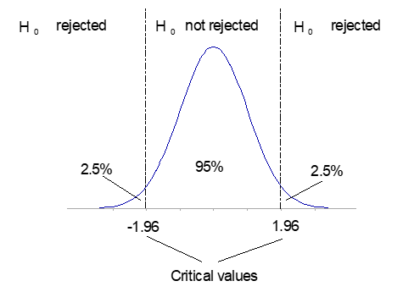
Step 3: Look up a critical value in a statistical table
The critical value is the dividing point between the region where the null hypothesis is rejected and the region where it is not rejected.

Slide 8
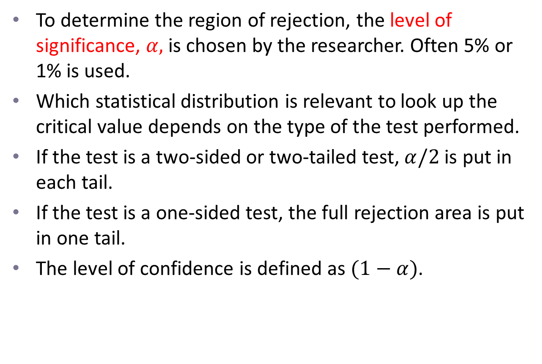
Step 3 continues
To determine the region of rejection, the level of significance, $α,$ is chosen by the researcher. Often 5% or 1% is used.
Which statistical distribution is relevant to look up the critical value depends on the type of the test performed.
If the test is a two-sided or two-tailed test, $α/2$ is put in each tail.
If the test is a one-sided test, the full rejection area is put in one tail.
The level of confidence is defined as $(1−α)$.

Slide 9

Step 4: Decision - Reject or not reject the null
If the test statistic is in the rejection area, we reject the null and the alternative seems to be true.
Example: $z=−2.1$ hence $−2.1<−1.96$ $⇒$ reject $H_{0}$

Slide 10
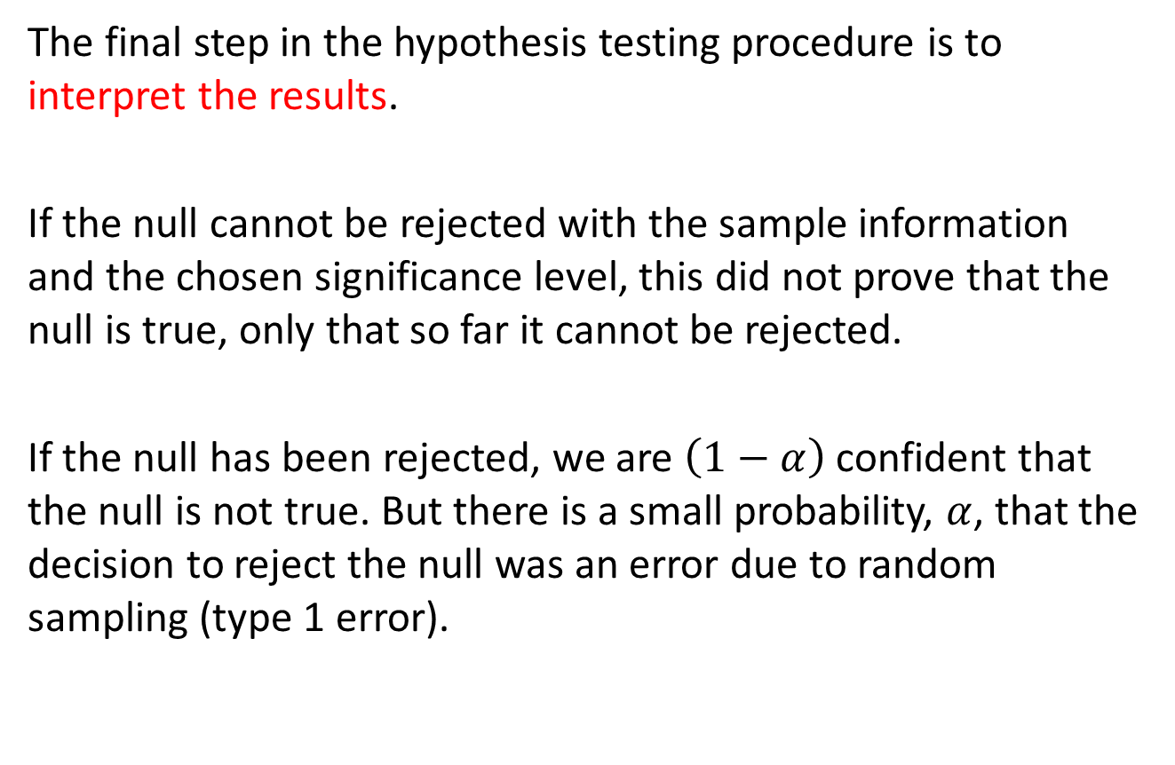
Step 5: Conclusion: What can be learned from the test
The final step in the hypothesis testing procedure is to interpret the results.
If the null cannot be rejected with the sample information and the chosen significance level, this did not prove that the null is true, only that so far it cannot be rejected.
If the null has been rejected, we are $\left(1−α\right)$ confident that the null is not true. But there is a small probability, $α$, that the decision to reject the null was an error due to random sampling (type 1 error).

Slide 11
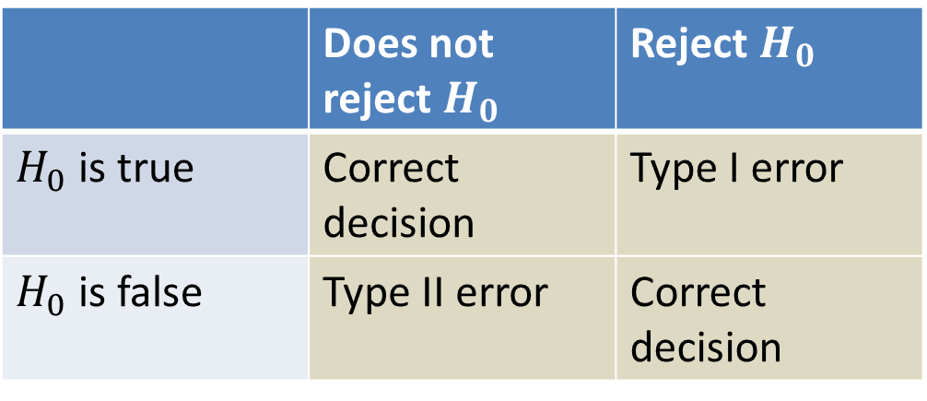
Type 1 and type 2 error
Type I error: Rejecting the null hypothesis when it is true.
Type II error: Not rejecting the null hypothesis when it is false.
 | Does not reject $H_{0}$ | Reject $H_{0}$
$H_{0}$ is true | Correct decision | Type I error
$H_{0}$ is false | Type II error | Correct decision

Slide 12
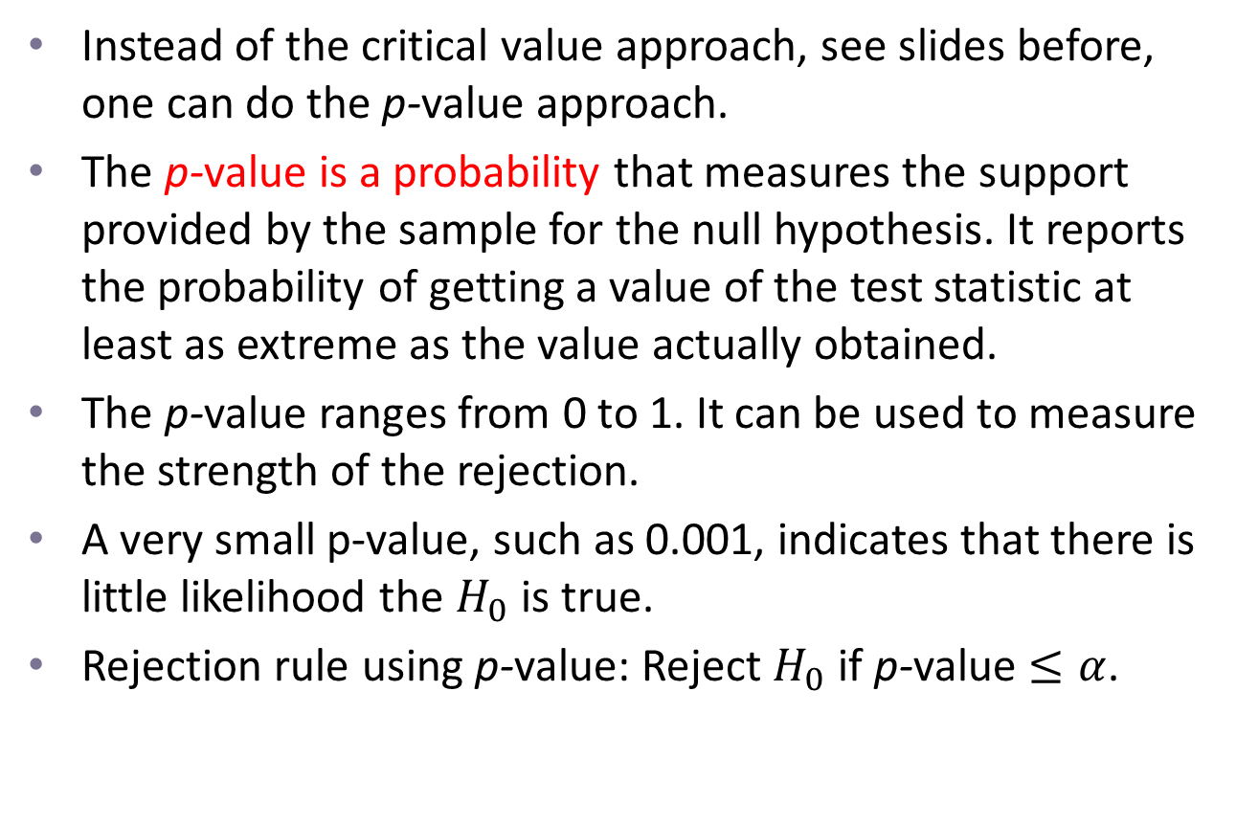
The p-value approach
Instead of the critical value approach, see slides before, one can do the p-value approach.
The p-value is a probability that measures the support provided by the sample for the null hypothesis. It reports the probability of getting a value of the test statistic at least as extreme as the value actually obtained.
The p-value ranges from 0 to 1. It can be used to measure the strength of the rejection.
A very small p-value, such as 0.001, indicates that there is little likelihood the $H_{0}$ is true.
Rejection rule using p-value: Reject $H_{0}$ if p-value $≤α$.

Slide 13
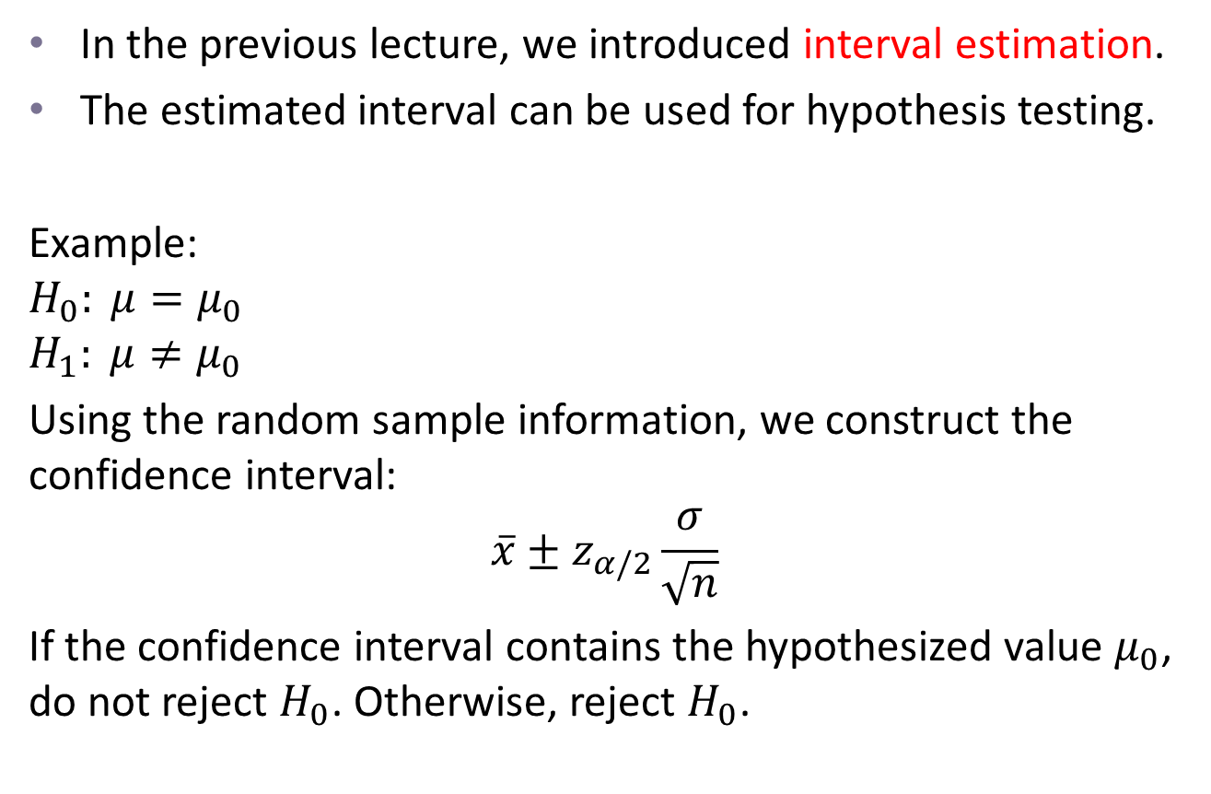
The confidence interval approach
In the previous lecture, we introduced interval estimation.
The estimated interval can be used for hypothesis testing.
Example:
$$H_{0}: μ=μ_{0}$$
$$H_{1}: μ≠μ_{0}$$
Using the random sample information, we construct the confidence interval:
$$\overline{x}±z_{α/2}\frac{σ}{\sqrt{n}}$$
If the confidence interval contains the hypothesized value $μ_{0}$, do not reject $H_{0}$. Otherwise, reject $H_{0}$.

Slide 14
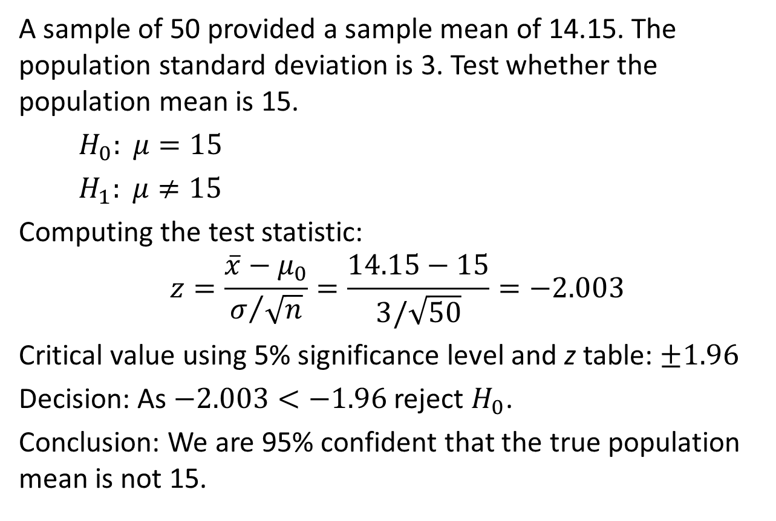

Example 1: $σ$ known, two-sided test
A sample of 50 provided a sample mean of 14.15. The population standard deviation is 3. Test whether the population mean is 15.
$H_{0}: μ=15$
$H_{1}: μ≠15$
Computing the test statistic:
$$z=\frac{\overline{x}−μ_{0}}{σ/{\sqrt{n}}}=\frac{14.15−15}{3/\sqrt{50}}=−2.003$$
Critical value using 5% significance level and z table: $±1.96$
Decision: As $−2.003<−1.96$ reject $H_{0}$.
Conclusion: We are 95% confident that the true population mean is not 15.

Slide 15
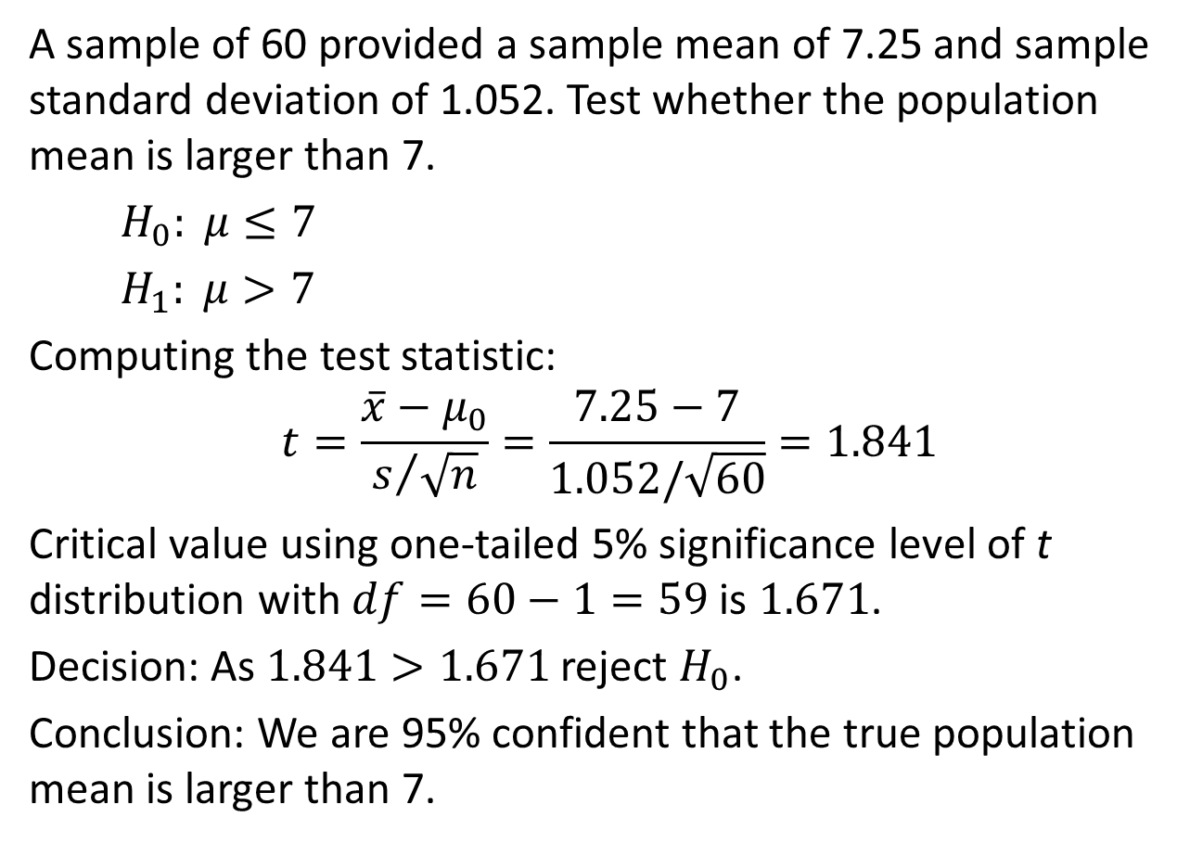

Example 2: $σ$ unknown, one-sided test
A sample of 60 provided a sample mean of 7.25 and sample standard deviation of 1.052. Test whether the population mean is larger than 7.
$H_{0}: μ≤7$
$H_{1}: μ>7$
Computing the test statistic:
$$t=\frac{\overline{x}−μ_{0}}{s/{\sqrt{n}}}=\frac{7.25−7}{1.052/\sqrt{60}}=1.841$$
Critical value using one-tailed 5% significance level of t distribution with $df=60−1=59$ is $1.671$.
Decision: As $1.841>1.671$ reject $H_{0}$.
Conclusion: We are 95% confident that the true population mean is larger than 7.

Slide 16
Next Lecture
Regression analysis

